Slide 1
CLASSIC SNAKE GAME
GROUPE : OKAY

Slide 2
Problem Statement
This project aims to build a snake game which satisfies the following requirements clearly :
  Snake can enter and exit through a specific section wall and emerge from the other (opposite) side.
  Speed and size of snake must increase on eating a unit of food, this thus increasing difficulty as the game progresses.
  Game gets over as soon as a snake touches its own body or touches the wall.

Slide 3
Main Objectives
Snake
  Attributes of snake object-length(size)=>1
  Snake starts at bottom-left corner.
  Snake's length increases as it consumes more food.
  Snake's speed increases linearly according its length.

Slide 4
Food
  Single unit increases length of snake by 1.
  Each food unit appears at random.
  Food cannot appear on any of cells. currently occupied by the snake.
Grid
  Grid size can be adjusted.
  Length , width of columns can be adjusted.
Technologies Used :
  visual studio community c++ 2017.
  framework.

Slide 5
Algorithms , Data Structures
Requirements:
  Maintains length dynamically.
  When no food eaten, length must remain same but snake must move forward. A new cube must be added at the front of the current snake and the last cube must be removed.
  If food is eaten by the snake, length should be increased by one.

Slide 6
Current level :
separate drawing code from logic: animation /game loop
control rectile velocity instead of movement : scope of variables
prevent rectile from balling out of control: classes/objects .h and .cpp ,adding member variables

Slide 7
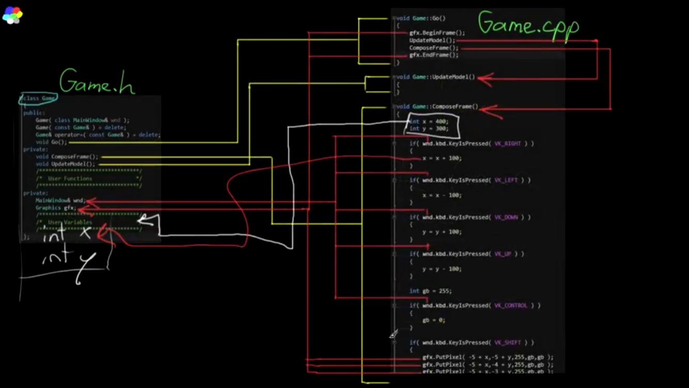
SNAKE GAME SNAPSHOT

